Slide 1
Virtual Annual Meeting
May 19, 2022
Notes:
Andrew

Slide 2
Agenda
6:00pm Welcome & Approval of Minutes - 2021 APDEM Annual Meeting
6:05pm Reports from APDEM Sister Societies
6:15pm APDEM Business Report
6:25pm Committee Updates Reports
6:56 pm New ACGME Common Program Requirements
7:00pm 2021 Endocrinology Subspecialty – ABIM Pass Rates
7:10pm Update: Milestones 2.0
7:15pm Q&A
7:25pm Acknowledgement of New/Recently-Transitioned Council Members
7:30pm Adjourn
Note: All questions to be answered should be posted in the Q&A Box.
Notes:
Andrew – If you have a question you would like answered please submit using the Q&A Box only. The Chatbox can be used for constructive comments, suggestions, shout-outs, etc.

Slide 3
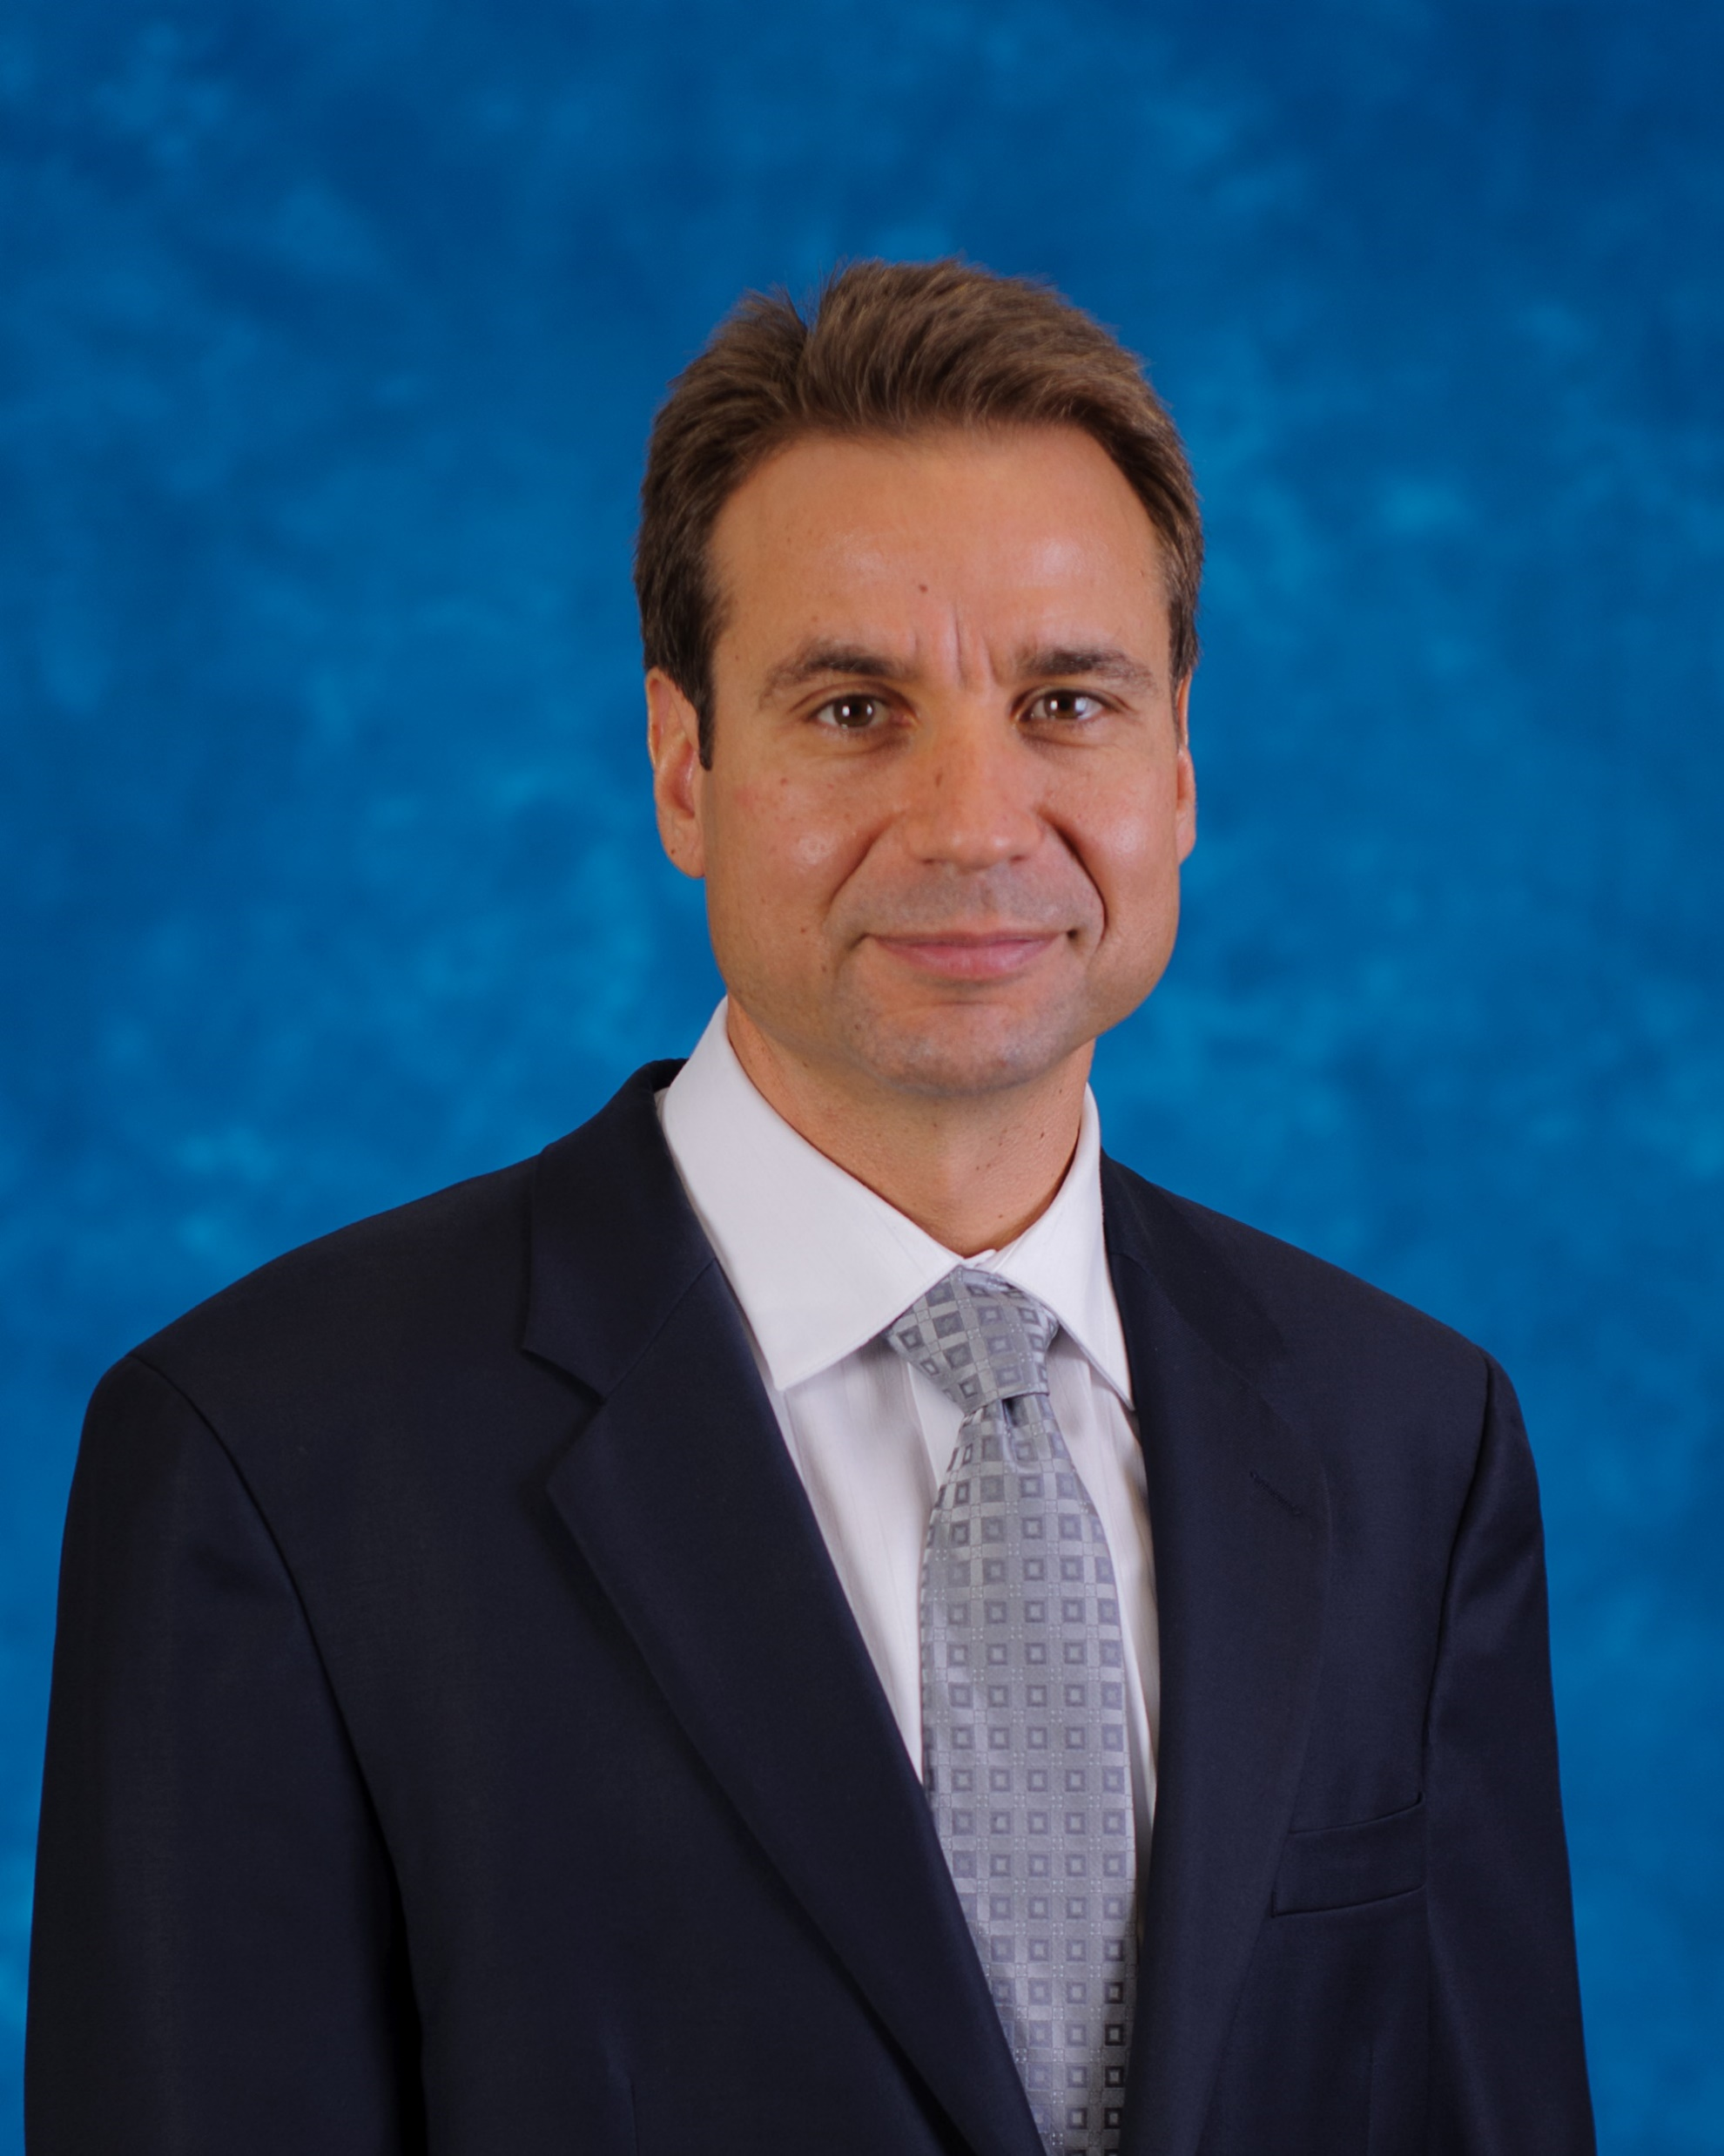
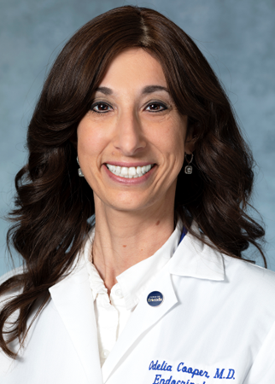
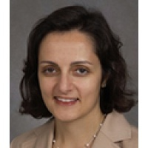
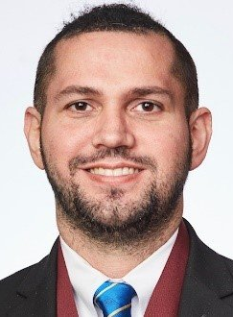
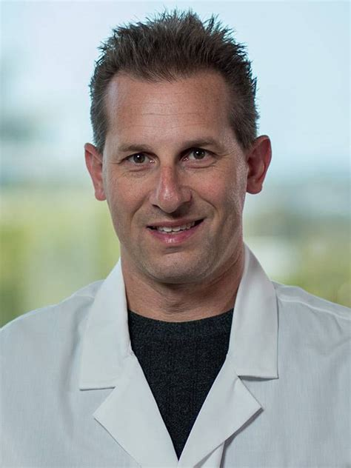
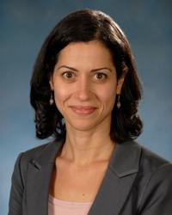
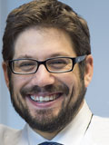
APDEM Council
APDEM Council Members
President
Andrew G. Gianoukakis, MD Harbor UCLA Medical Center
President-Elect
Odelia Cooper, MD Cedars-Sinai Medical Center
Secretary-Treasurer
Marina Charitou, MD SUNY Stony Brook Hospital
Ricardo Correa, MD, EdD
University of Arizona College of Medicine - Phoenix
Matthew Levine, MD Scripps Green Hospital
David C. Lieb, MD Eastern Virginia Medical School
Rana Malek, MD University of Maryland
Roberto Salvatori, MD Johns Hopkins University
Notes:
Andrew

Slide 4
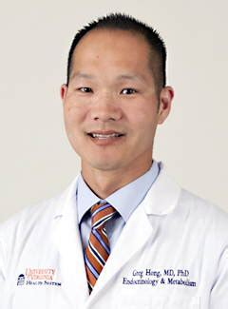
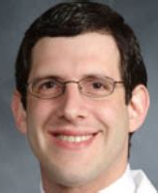
Welcome New Officers and Council Members
Odelia Cooper, MD President
Rana Malek, MD Secretary-Treasurer
Gregory K. Hong, MD, PhD
Council Member
Aaron Schulman, MD
Council Member
Notes:
Andrew - Thank you to over 60% of the APDEM membership who approved this year’s ballot.

Slide 5
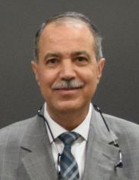
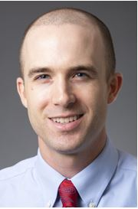
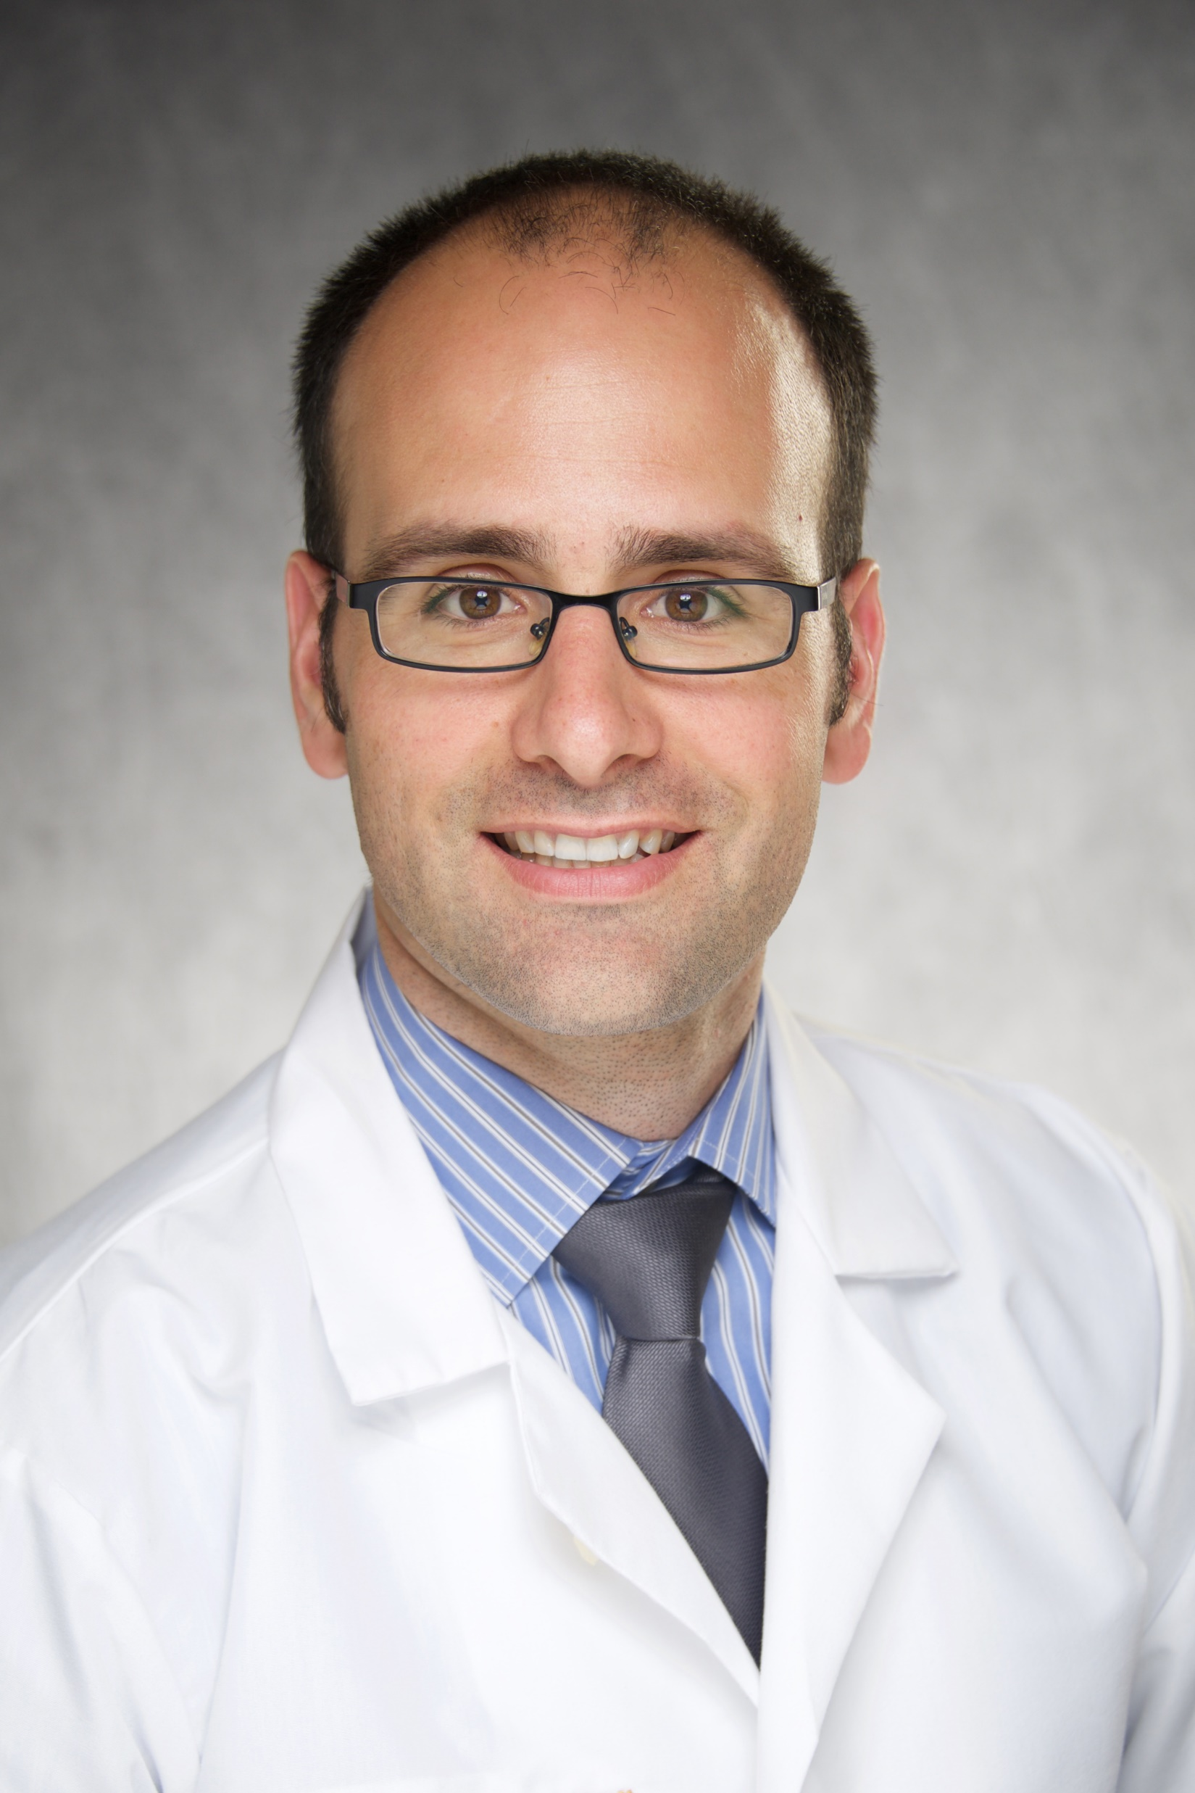
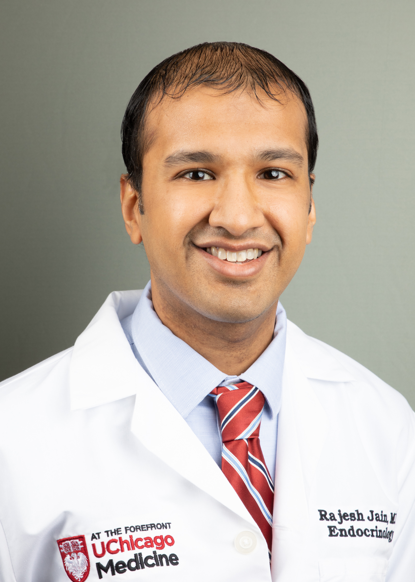
Welcome New Program Directors
Saleh Aldasouqi, MD, FACE, ENU
Program Director
Chief, Division of Endocrinology and Metabolism
Michigan State University
Endocrinology, Diabetes & Metabolism Fellowship
Andrew Crawford, MD
Program Director
Assistant Professor of Medicine
Dartmouth-Hitchcock Medical Center
Endocrinology Fellowship
Brian T. O’Neill, MD, PhD
Program Director
Assistant Professor of Internal Medicine
University of Iowa
Diabetes, Endocrinology and
Metabolism Fellowship
Rajesh K Jain MD
Program Director
Endocrinology Fellowship
Assistant Professor of Medicine
University of Chicago Medicine
Section of Endocrinology, Diabetes, and Metabolism
Notes:
Andrew

Slide 6
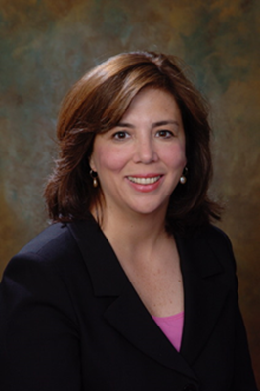
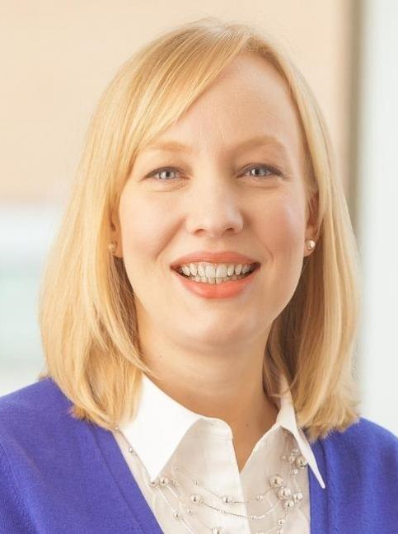
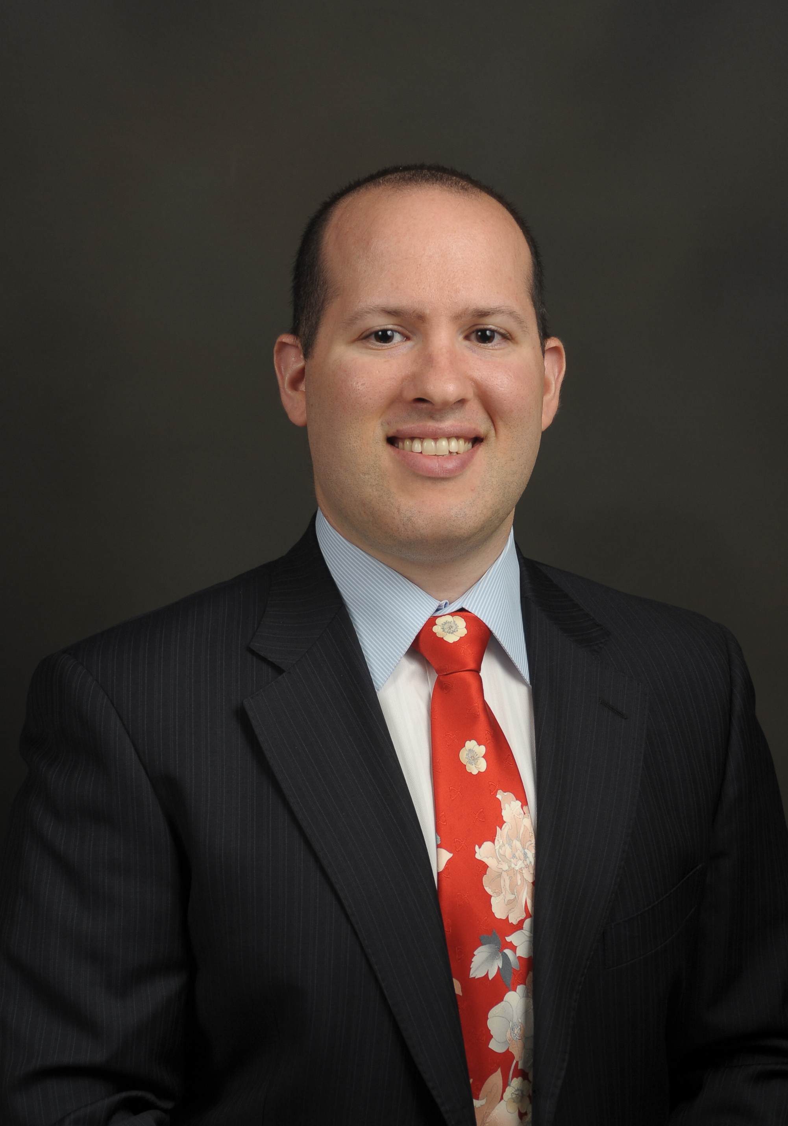
Welcome Incoming Program Directors – July 2022
Patricia Bononi, MD, FACP
Allegheny Health Network
Endocrinology Fellowship
Amy S Neumeister, MD, FACP
University of Nebraska Medical Center
Endocrinology Fellowship
Gary D. Rothberger, MD, ECNU
NYU Langone Hospital- Long Island
Endocrinology, Diabetes & Metabolism Fellowship
Notes:
Andrew

Slide 7
Approval of the Minutes – ApDEM Virtual Annual Meeting – April 19, 2021
Dr. Andrew Gianoukakis
Notes:
Andrew
The first order of business is to have a motion of approval for the minutes from last year’s virtual Annual Meeting.

Slide 8
Sister Society Updates 6:05 – 6:15 p.m.
American Association of Clinical Endocrinology – Felice A. Caldarella, Md, FACP, CDCES, MBA, FACE; President
American Thyroid Association – Peter Kopp, MD; President
Endocrine fellows foundation – John P. Bilezikian, MD; Chair
Endocrine Society – Jeffery Boord, MD; Secretary/Treasurer-Elect
Pituitary Society – Maria Fleseriu, MD; Co-Director, Programs
Notes:
Andrew (to introduce and thank sister societies again)
Moving to our Sister Society updates, I’d like to introduce in alpha order, our five partnering organizations from our Sister Societies. We are fortunate today to have representatives from each organization who will be making brief presentations.
First we have
Felice Caldarella, President, APDEM
Followed by
Peter Kopp, President of the American Thyroid Association and
Our newest partner, The Endocrine Fellows Foundation will be presented by John Bilezikian, Chair, EFF
Jeffrey Boord, Secretary/Treasurer-Elect of the Endocrine Society.
And lastly, Maria Fleseriu, Co-Director of Programs of the Pituitary Society.
Felice, if you could please start us off..

Slide 9
Notes:
Updated

Slide 10
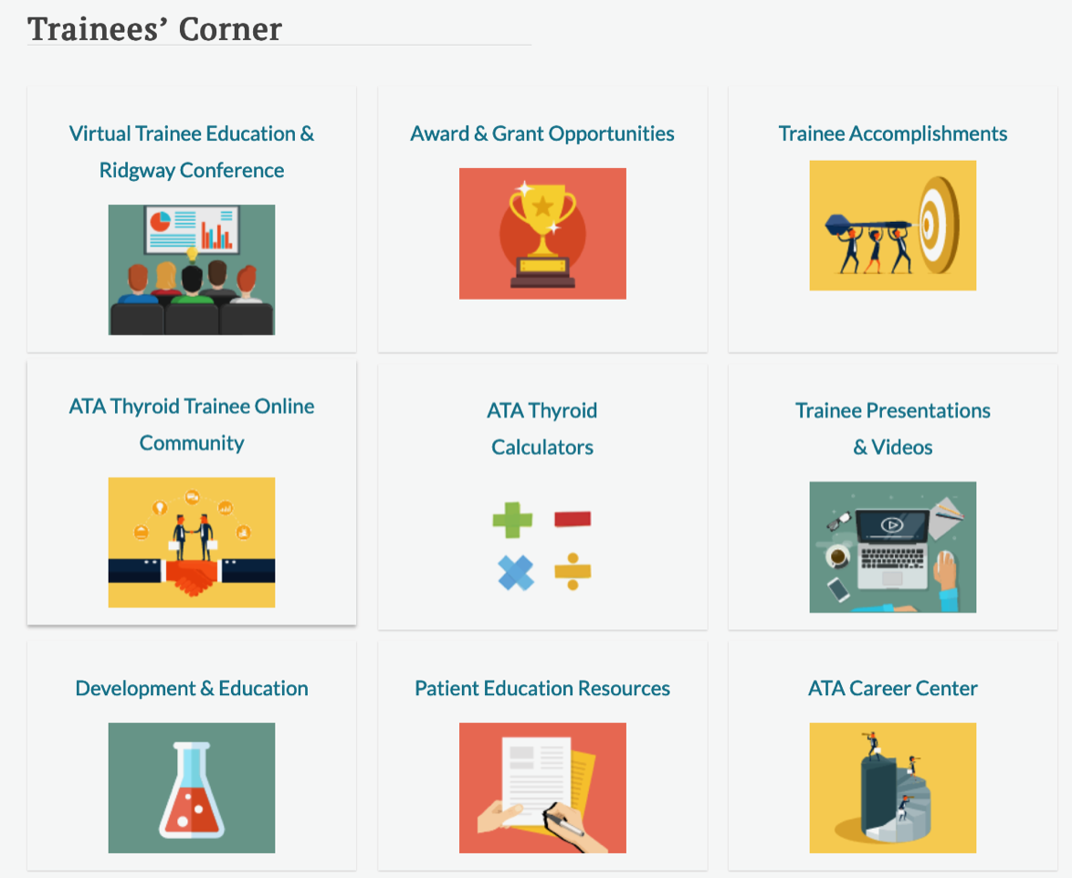
Resources for Programs & Trainees
E. Chester Ridgway Conference – Agenda Posted Online for October 2022
Travel grants available for trainee poster presenters
Thyroid Health Blog
Virtual Education Library and complimentary webinars
https://ata.ce21.com/
Directed Therapies for Thyroid Nodules
Coming Soon – Ultrasound Basic, Advanced and Interventional videos
New Guidelines & Statements - 2021 Anaplastic Thyroid Cancer Guidelines and teaching tools (slides and videos) - https://www.thyroid.org/professionals/ata-professional-guidelines/
Annual research grants and presentation awards
Patient Education Resources, including Clinical Thyroidology for the Public
ATA Career Center - https://careers.thyroid.org/
Committee Service
Thyroid, VideoEndocrinology, Clinical Thyroidology - https://www.thyroid.org/professionals/ata-publications/
https://www.thyroid.org/91st-annual-meeting-ata/program/
Notes:
ATA is committed to creating a community of exchange and developing resources and tools to support program directors and trainees. Some highlights for you are:
Research Grants
Annual grant program to support research; available exclusively for members
New webinar series on topics such as thyroid cancer, hormone disrupting chemicals, immunotherapy and thyroid disfunction, and more!
Discounted registration for all ATA members and free for ATA trainee members. Nonmember trainees can access the webinar series for a $90 registration rate.
Available live and on-demand released through the end of August; many include live Q&A with speakers.
ATA Guidelines
Many are currently available online. Later this year we’ll release the Anaplastic Thyroid Cancer Guidelines, including resources for you to use as teaching tools.
3 new guidelines will be published next year
Differentiated Thyroid Cancer Guidelines
Thyroid Nodules Guidelines
Pediatric Thyroid Cancer Guidelines
Pocket guides are also available through Guideline Central
COVID-19 Resources
Available online and include guidance documents on Thyroid FNA and Thyroid surgery during the pandemic.
Patient FAQ to help navigate care during COVID.
Ridgeway Trainee Conference
Past sessions available for everyone to access on sessions.thyroid.org
Exploring exciting virtual opportunities for later this year
Past annual meeting talks are available in our virtual education library – sessions.thyroid.org
Our thyroid nodule calculators to provide guidance and recommendations for practice areas concerning thyroid disease and thyroid cancer.

Slide 11
Our history and inspiration
What do we do?
Offer educational opportunities for Fellows that extend the reach of their own programs.
How do we do it?
Preceptorials in Metabolic Diseases and Diabetes (including obesity and metabolism)
Forums in collaboration with the ENDO, ASBMR, and the Santa Fe Bone Symposium
Accepting Applications for the EFF-ASBMR Forum Sept 7-8, 2022
Research Grant Program
Spring Cycle: 8 Fellows awarded $7,500 grants
Fall Cycle: Applications open, June 10, 2022
Active Web Site www.endocrinefellows.org
Features articles shared by our community and links to other organizations.
Lectures from forums continually refreshed and available
Articles published by fellows info@endocrinefellows.org
Leadership
Mark Stolar, President; John Bilezikian, Chair; Derek LeRoith, Treasurer; Anna Raji, Director;
Ricardo Correa, Director; Jennifer Kirkwood, Executive Director

Slide 12
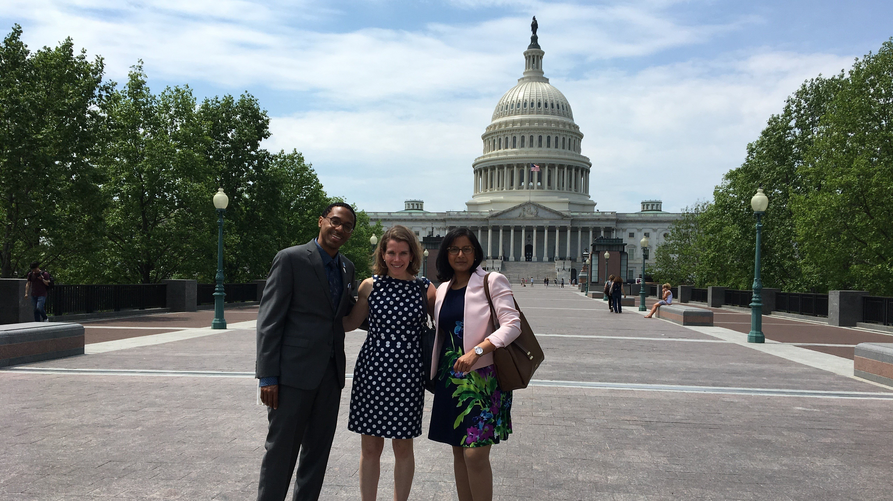
Advocacy
Membership
Notes:
Good evening. My name is Jeff Boord and I am the Chief Quality and Safety Officer for Parkview Health, in Northeast Indiana. I am also a practicing endocrinologist and a faculty member at the Indiana University School of Medicine. It is my pleasure to join you in my role as Secretary/Treasurer-Elect of the Endocrine Society. The Endocrine Society is committed to providing a professional home for all endocrine researchers and practitioners and I am proud of our signature resources for basic science and clinical trainees, and educators.
Tonight, I’ll be highlighting just a few of the Society’s programs, beginning with ENDO 2022 which will be held June 11-14 in Atlanta. This year’s program offers registrants the option of attending in-person or virtually. In addition to 150 live sessions, we’ll be offering unique experiences such as the new Digital Poster Pods and our new Communications & Career Center --offering education, news, and networking in one location.
The Endocrine Society is once again pleased to offer complimentary membership to your institution’s basic science and clinical first-year fellows.
As educators, we are always looking for ways to expand and improve resources to support our students and faculty. The Society’s updated Fellows Training Series is a comprehensive program designed to support you as the educators of the next generation of endocrinologists.
Like you, we are concerned about the decline in the endocrinology board pass rates. The Society’s In-Training Exam is one of the best tools to assess your fellows’ strengths and weaknesses. And as many of you know, performance on the In-Training Exam is a strong predictor of pass rates on the ABIM exam.
Our newest program, Excellence in Clinical Endocrinology Leadership, also known as ExCEL, offers comprehensive leadership training and mentorship to early-career physicians of communities underrepresented in medicine and science. This program is geared toward those beginning their endocrine fellowship or making the transition to early-career status. ExCEL builds leadership skills, explores opportunities for advancement, and expands networks to include new peers and potential mentors.
The Endocrine Society’s monthly Endocrine Feedback Loop, a journal club podcast series, features an expert educator and a topic specialist reviewing recently published articles on a variety of clinical topics. Endocrine Feedback loop provides endocrinologists at all stages of their careers with new insights into emerging topics in clinical endocrinology.
As your fellows are the future of endocrinology, we hope you will encourage them to participate in our many advocacy efforts and to help us influence policies and legislation affecting endocrine-related research and practice. As the only endocrine organization with an advocacy program, we are working even harder to represent your interests on Capitol Hill.
Registration is now open for CEU, which returns to a hybrid meeting format September 8-10 in Miami.
This year’s Endocrine Board Review, EBR, will be held online only, September 16-18. EBR is the ideal live online course for preparing for certification or recertification, or for endocrinologists pursuing a comprehensive self-assessment. The program includes live Q&A with expert faculty.
For more information all on all Society programs and resources, please go to www.endocrine.org.
Thank you.

Slide 13
Pituitary Society

Slide 14
Thank yoU for your continued support! APDEM Business Report 6:15 – 6:25 p.m.
Dr. Marina Charitou
Notes:
Marina

Slide 15
Membership Update (Since Last Annual Meeting)
 | May 2022 | April 2021
Current Members (June 2021 – May 2022 ) | 124 | 100
Newly joined/rejoined members (since last annual meeting) | 12 | 1
Lapsed Members (lapsed June 2020) | 2 | 14
Non-Members (ACGME approved Institutions) | 34 | 37
Total Potential Members: | 158 | 152
Membership update since our last virtual annual meeting in April 2021
Currently sending renewals for the 2022-2023 academic year.
Via emails to PDs and PCs
Reminders to be circulated again
Contact apdem@endocrine.org to check membership terms and with any questions
Notes:
Marina –
APDEM currently has 124 active member programs, and we currently have only 2 programs who membership have lapsed from June 2020.
With the goal of 100% membership among all ACGME Endocrine Fellowship programs, APDEM will seek to connect with non-member programs in the coming year to welcome them to the membership. APDEM’s potential member target is 158.
As you’ll see throughout today’s presentation, APDEM provide much needed support and resources for Program Directors and provides a forum to contribute to our fellowships. Please continue to maintain your membership. You will have already received membership renewal notices and reminders will be going out shortly, and we need all programs to contribute more so now.
Just a reminder, your APDEM membership is for the Endocrine Fellowship Program and includes your program director, associate program director and program coordinator. To make sure your program files are up-to-date, please email APDEM@endocrine.org.

Slide 16
Welcome - New Fellowship Programs to APDEM:
Advocate Health Care/Advocate Christ Medical Center
Baystate Medical Center/Tufts University School of Medicine
KPC Health Program
Medical University of South Carolina
National Capital Consortium/Walter Reed National Military
New York-Presbyterian Hospital – Columbia Campus
Rochester Regional Health/Unity Hospital
Texas A&M College of Medicine/Scott and White Memorial Hospital
Tufts University Medical Center
University of California – San Francisco
University of Puerto Rico
University of Texas Health Science Center School of Medicine, San Antonio
Notes:
Marina – Welcome to new programs and newly rejoined program to APDEM.

Slide 17
Treasurer’s Report: APDEM Finances
 | 12/31/2021 | 12/31/2020
Net Assets | $212K (unaudited) | $226K
Notes:
Marina
APDEM continues to remain in good financial health with net assets of just over $200K.

Slide 18
APDEM Business Report: Budget
Notes:
Marina
APDEM continues to remain in good financial health.
Primary investments in 2021 were the administrative time, upkeep from staff and the annual audit which led to a deficit in the budget.
APDEM Membership rates were increased in 2021 from $200 to $250 to account for the shortfall.
For 2022, in order to have a balanced budget, APDEM leadership made the decision to once again hold an virtual Annual Meeting which was a savings of $8000. Additionally made a decision about the annual audit which will save on both staff time and professional fees.

Slide 19
APDEM Business Report
Assessing the need for an Annual Audit
Current Amendment:
Section 11.3 Audit. Within a reasonable time after the conclusion of each fiscal year, the financial records of the Association shall be audited by a certified public accountant selected by the Council. Any audit report, and statements of financial condition, shall be available to all members of Council promptly upon conclusion of the audit.
Proposed Amendment:
Section 11.3 Audit. The financial records of the Association shall be audited by a certified public accountant selected by the Council once every five years, with the option for Council to approve an earlier audit ad hoc, but an audit should be conducted no less than every five years. Any audit report, and statements of financial condition, shall be available to all members of Council promptly upon conclusion of the audit.
.
Notes:
Marina
In December, APDEM leadership met with Jay Sciuto, partner of the auditing firm used by the Endocrine Society for APDEM’s annual audit.
The purpose of the meeting was to assess the need of an annual audit which is currently required in the APDEM Bylaws.
Staff time to prepare for the audit and the expense of the audit account for over 18% of APDEM’s annual budget.
Mr. Sciuto was confident that an annual audit for an organization the size of APDEM was in excess of what is truly needed. In his 20 years of overseeing APDEM’s audits, there was never a question about the reporting data.
As a cost-savings measure, APDEM Council voted to amend the current Bylaws with regard to an annual audit and require that an audit be conducted once every five years or sooner but no less than every five years.
In order to amend the Bylaws, a ballot will be circulated to APDEM’s membership with the proposed amendment. To amend the Bylaws, Council will need to receive at least two-thirds approval from the voting membership.
The APDEM Finance Committee will continue to provide oversight to the APDEM finances.

Slide 20
APDEM Committee Updates 6:25 – 6:56 p.m.
Dr. Odelia cooper
Notes:
Odelia

Slide 21
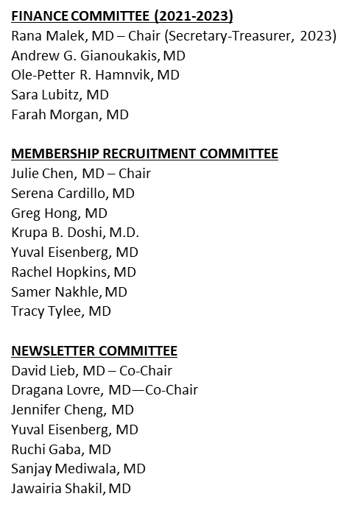
APDEM Committee Update – Committee Rosters for FY 2022-2023
CURRICULUM and MILESTONES EVALUATION COMMITTEE –NEW!
Rana Malek – Co-chair
Ole-Petter R. Hamnvik, MD—Co-chair
Saleh Aldasouqi, MD
Ahmet Selcuk Can, MD
Jennifer Cheng, MD
Krupa Doshi, MD
Katie Guttenberg, MD
Jeehea Sonya Haw, MD
Rachel Hopkins, MD
Pooja Luthra, MD
Sarah Mayson, MD
Lakshmi Pakath Menon, MD
Jawairia Shakil, MD
Ismat Shafiq, MD
Imali Sirisena, MD
Stephanie Smooke, MD
Emily Szmuilowicz, MD
COVID TASK FORCE
David Lieb, MD –Chair
Pandemic Emergency Status
Aaron Schulman, MD (as needed)
Fellow Recruitment Subcommittee
Greg Hong, MD – Co-chair
Saira Khan, MD – Co-chair
Vivian Fonseca, MD
Matthew Gilbert, MD
Kristen Gill Hairston, MD
Tricia Santos, MD
Amale Lteif, MD
Abid Yaqub, MD
DIVERSITY, EQUITY & INCLUSION COMMITTEE
Ricardo Correa – Co-chair
Pooja Luthra, MD – Co-Chair
Saleh Aldasouqi, MD
Julie Chen, MD
Ruchi Gaba, MD
Sonya Haw, MD
David Lieb, MD
Farah Morgan, MD
Emily Szmuilowicz, MD
Karyne Lima Vinales, MD
Soumya Thumma, MD
APDEM COUNCIL
Odelia Cooper, MD – President (2023)
Andrew G. Gianoukakis, MD –
Immediate-Past President (2023)
Rana Malek, MD--Secretary-Treasurer (2023)
Ricardo Correa, MD (2023)
Greg Hong, MD (2024)
Matthew Levine, MD (2023)
David Lieb, MD (2023)
Aaron Schulman, MD (2024)
ALL IN-MATCH OVERSIGHT TASK FORCE
Matthew Levine, MD – Co-chair
Aaron Schulman, MD – Co-chair
Matthew Gilbert, MD
Katie Guttenberg, MD
Lakshmi Pakath Menon, MD
Ismat Shafiq, MD
Odelia Cooper, MD (ex-officio, non-voting)
Notes:
Odelia

Slide 22
APDEM Curriculum Update (Member Only Benefit)
Adrenal
Bone and Mineral Metabolism
Diabetes
Hypothalamic-Pituitary
Lipid Metabolism
Nutrition and Obesity
Reproductive Endocrinology
Thyroid
Transgender – new
Health Equity – new
Notes:
Odelia

Slide 23
Transgender Medicine Curriculum
Task force, chaired by Josh Safer and Odelia Cooper
Marina Charitou
Caroline Davidge-Pitts
Ole-Petter Hamnvik
Vin Tangpricha
Components of curriculum
Background
Assessments
GAHT strategies and protocols
Surgery
Fertility
Preventive health screenings
Expectations for PDs
Resources
Cases
Notes:
Odelia

Slide 24
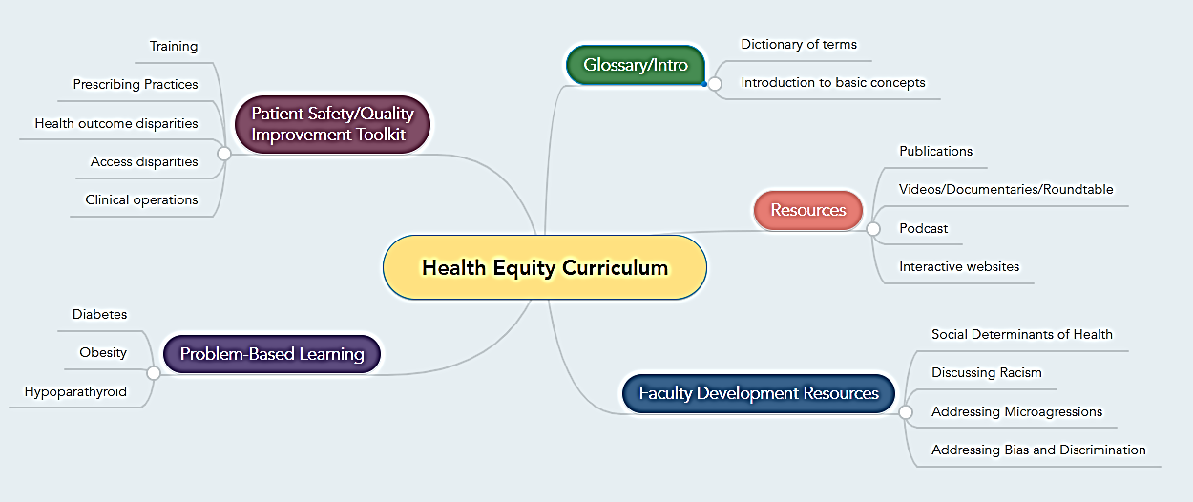
Health Equity Curriculum Overview
Rana Malek –lead
Sarah Mayson – Co-Chair
Ricardo Correa
Andrew G. Gianoukakis
Sonya Haw
Pooja Luthra
Dave Lieb
Farah Morgan
Amal Rahhal
Imali Sirisena
Stephanie Smooke
Emily Szmuilowicz
Slide courtesy of Dr. Sonya Haw

Slide 25
Membership Recruitment Committee
124 members; 34 non-members or lapsed members.
January 2022-June 2023 – Special 18-month discounted rate membership.
Goal is 100% membership of all ACGME Accredited Endocrine Fellowship programs.
The committee will continue to contact non-member programs.
Survey input of members
Notes:
Odelia

Slide 26
Membership Recruitment Committee
Membership Survey deployed on May 10
Preliminary results based on 37 program director respondents
Notes:
Odelia

Slide 27
Membership Recruitment Committee
Q4. In addition to the above, what other resources or activities could APDEM provide which would improve your experience as a member program?
Speaker bank, Board prep Curriculum development
It can be challenging to keep track of the documents that come out. Recommend there be an online portal with a repository of the curriculum materials and past newsletters.
Sharing helpful information about meeting REC requirements and related to site visits
I would like to help coordinate a group where we discuss how we organize our fellowship programs, what rotations we all have our fellows participate in, call schedules, didactics topics, schedules, etc. We can all learn from each other and I think it would be fun and very interesting and helpful to see what others are doing.
Guideline on how fellows meet certification for thyroid ultrasonography and FNA
In-person meeting
Board review suggestions / discussions
Curriculum for diversity
Resources and discussions such as emails or forums where PDs can ask questions and share experiences and ideas.
I think it really helps to know what other programs are doing across the country. e.g. what are the research requirements of the program? or even more basic things: how many weeks of consults, or how many different sites do the fellows rotate at?
Networking opportunities with other PDs to compare how other programs are set up and get ideas on how to improve our program
Endocrine specific safety training materials as this is an ACGME requirement not easily met
Organizing lectures shared between programs. there was initiative but somehow this was forgotten
Notes:
Odelia

Slide 28
Membership Recruitment Committee Future Goals
APDEM directory
Welcome package for new members
Virtual binder of materials
Networking events
Social platforms (Join our active Facebook group!)
Continue to survey input of members

Slide 29
ALL-in match oversight task force 6:33 – 6:40 p.m.
Dr. Matthew Levine
Notes:
Odelia to introduce

Slide 30
APDEM All In Match Oversight Task Force
AY 2021-2022
Matthew Levine (Scripps) – Co-chair
Aaron Schulman (Weill Cornell) – Co-chair
Matthew Gilbert (U Vermont)
Ismat Shafiq ( U Rochester)
Amal Shibli-Rahhal (U Iowa)
Andrew Gianoukakis (LA County- Harbor-UCLA) - ex officio, non-voting
AY 2022-2023
Matthew Levine (Scripps) – Co-chair
Aaron Schulman (Weill Cornell) – Co-chair
Matthew Gilbert (U Vermont)
Katie Guttenberg, MD (U Texas Houston)
Lakshmi Pakath Menon, MD (U Arkansas)
Ismat Shafiq ( U Rochester)
Amal Shibli-Rahhal (U Iowa)
Odelia Cooper, MD (Cedars Sinai) – ex officio, non-voting
Notes:
Matthew

Slide 31
APDEM All In Match OversiMemorandum of Uhttps://www.surveymonkey.com/r/PT6F92Tnderstanding APDEM’s “All In” Policy for the Endocrinology Match (2022 Recruitment Season for appointment in the 2023-2024 academic year)ght Task Force
Memorandum of Understanding APDEM’s “All In” Policy for the Endocrinology Match (2022 Recruitment Season for appointment in the 2023-2024 academic year)
This Memorandum of Understanding (MOU) is between the Association of Program Directors in Endocrinology, Diabetes, and Metabolism (APDEM; 2055 L Street, Suite 600, Washington, DC 20036)—sponsor for the National Resident Matching Program (NRMP) Endocrinology Match—and the following Accreditation Council for Graduate Medical Education (ACGME)-accredited fellowship training program in Endocrinology, Diabetes, and Metabolism (Internal Medicine):
Name of Program:
Program City/State:
Background: APDEM implemented an All In Match Policy for the Endocrinology Match starting in the 2018 recruitment season (for appointment in the 2019-2020 academic year [AY]). The goal of the Policy is to encourage all ACGME-accredited endocrinology training programs to participate in the NRMP Medical Specialties Matching Program (MSMP) and to offer all training positions through the MSMP—unless an exception is granted by APDEM. Effective July 1, 2018, endocrinology training programs adhering to the All In Match Policy will receive uninterrupted access to fellowship candidate applications via the Electronic Residency Application Service (ERAS). Effective July 1, 2018, demonstrable failure to adhere to the All In Match Policy will result in a revocation of ERAS access for up to two years, and it could lead to NRMP sanctions.
Purpose of the MOU: The sole purpose of this MOU is to establish and document that each Program understands APDEM’s All In Match Policy for the 2022 recruitment season (appointment for AY 2023-2024). This MOU does not represent an agreement to adhere to the All In Match Policy, and it does not represent an agreement to execute and abide by the NRMP Match Participation Agreement.
3. Training Program Responsibilities: Programs that enter into this MOU acknowledge that they understand APDEM’s All In Match Policy for the 2022 recruitment season (appointment for AY 2023-2024).
4. MOU execution and ERAS Access and Listing:
Programs that execute this MOU with APDEM (by completing and submitting this survey form) by Friday, May 13, 2022, at 5:00 p.m. EDT: a) will be listed in ERAS as a participating program in early June 2022; and b) will be able to receive candidates’ ERAS applications using the ERAS Program Director WorkStation beginning on July 20, 2022.[1]
Programs that execute this MOU after Friday, May 13, 2022, will have access to candidates’ applications, and they will be listed in ERAS as a participating program, but they may not initially be visible to candidates (as a participating program) in early June. ERAS will NOT inform candidates of the late addition of participating programs.
Programs that do not execute this MOU will not be listed in, nor have access to, ERAS for the 2022 recruitment season.
5. Understanding: Only the Program Director has authority to execute this MOU with APDEM (by completing and submitting this survey form) on the Program’s behalf. This MOU shall commence on the date the Program executes this MOU and will remain in full force and effect until June 30, 2023. Any additions or amendments to this MOU must be in writing and signed by both parties.
Name of Program Director Completing MOU:
Program Director Email Address:
Endocrinology Program's Name:
ACGME ID#:
Date:
(1) NOTE: To obtain access to ERAS, programs must do two things: (1) programs must register in ERAS (in early April, ERAS will send to each program login and password information to register in ERAS Account Maintenance); and (2) programs must execute (i.e., sign and deliver to APDEM) this MOU. If a program completes ERAS registration but has not executed this MOU, ERAS will change the program’s participation status from “Participating” to “Not Participating.”
Notes:
Matthew
150 programs signed the MOU.
1 program never signs – Medical College of Georgia
1 program in violation of last year’s MOU and is not being allowed ERAS access (Larkin)

Slide 32
APDEM All In Match Oversight Task Force
APDEM All In Match Policy – Updated February 2022
All endocrinology positions must be allocated through the NRMP Match (unless an exception is granted by APDEM and the NRMP). This policy applies to all endocrinology programs and all endocrinology positions.
Each year, APDEM will execute an All-In Match agreement with the NRMP: (1) any program registering for the Match must attempt to fill all positions through the Match; (2) programs planning to participate in the Match cannot offer positions outside the Match prior to program director registration and program activation; and (3) once a position has been offered outside the Match, the program no longer is eligible to enroll in the Match unless an exception has been granted by APDEM and the NRMP.
All exception requests should be submitted to APDEM (apdem@endocrine.org) with NRMP carbon copied (policy@nrmp.org) at least 3 weeks before a decision is required.
All exception requests will be assessed by APDEM’s All In Match Oversight Task Force, but final decisions will rest with APDEM Council.
Exception request letters should include details about the position to be offered, the applicant to whom the position will be offered, and any additional circumstances relevant to the request. The letter must be signed and submitted by the Program Director.
APDEM intends to grant the following exceptions to its All In Match Policy:
1. Military appointees to civilian programs.
Demonstrable candidate participation in the ABIM Research Pathway, when entry into the main residency match included a priori plans to pursue endocrinology fellowship at the same institution upon completion of 2 years of clinical training in the Internal Medicine residency program.¹
Candidates for formally-combined training programs designed to provide board eligibility for two different specialties with different NRMP codes (e.g., adult and pediatric endocrinology). ²
Replacement of a fellow that resigns or is dismissed or replacement of a matched fellow that does not start training. ³
A program that receives new accreditation from ACGME or receives approval for a permanent complement increase from ACGME and intends to recruit fellowship applicants at any point from Match Day until and including June 30 of the same academic year.⁴
________________
¹Such exception requests must include the Program Director’s confirmation that the candidate’s entry into the Internal Medicine (IM) residency program included a priori plans to pursue fellowship at the same institution upon completion of 2 years of IM training.
²Such exception requests must: a) be submitted by all program directors overseeing the combined training program; b) include evidence that the combined program is a formal and established one (e.g., a website link); and c) confirm that the fellow will be dually board-eligible upon successful graduation from the combined program.
³Such exception requests must be co-submitted by the program and the program’s Designated Institutional Official (DIO). In addition, APDEM primarily intends to grant this exception only for the replacement of fellows who did not achieve 75% of the required clinical training. Replacement of a trainee and initiation of training prior to October 1 does not require APDEM approval.
⁴Such exception requests will require the signature of both the Program Director as well as the Sponsoring Institution’s Designated Institutional Official (DIO) and should also include either the letter from the ACGME confirming the date that the program received its accreditation or confirming the date that the program was granted a complement increase.
Notes:
Matthew

Slide 33
APDEM All In Match Oversight Task Force
APDEM All In Match Policy – Updated February 2022
Although APDEM intends to grant the aforementioned exceptions, all Match exceptions (including the foregoing) must be formally requested by the program and specifically granted by APDEM.
APDEM will permit programs to request exceptions for situations not listed above (items 1-5); these will be considered on a case-by-case basis. However, only highly compelling exception requests will be eligible for approval through this mechanism, and such exception requests would need to be co-submitted by the program and the program’s DIO. APDEM does not intend to grant exceptions that can be reasonably addressed via the NRMP Match (or by other means).
This All In Match policy does not prohibit out-of-Match arrangements when a program fails to match to its full NRMP quota (i.e., “does not fill”). In such cases, the program may fill the unfilled position outside of the NRMP Match (e.g., via a “scramble”). As long as candidates are available to begin training by October 1 of the corresponding academic year and as long as the arrangement is made between Match Day and September 30, neither NRMP nor APDEM will penalize such out-of-Match arrangements, and programs do not need to obtain APDEM’s or NRMP’s approval for such arrangements. However, it is expected that programs will make every effort to recruit such candidates and have them begin training by July 1 of the corresponding academic year (i.e., before the next recruitment season begins). If such arrangements are made on or after October 1, or if the candidate is not available to begin training by October 1, a formal exception request must be submitted to APDEM.
Each year, only those Programs that execute a Memorandum of Understanding regarding APDEM’s All In Match Policy will (a) be listed in ERAS, (b) be available in ERAS for candidates to select, and (c) be able to receive candidates’ ERAS applications using the Program Director Work Station.
Policy adherence assessments
Early each academic year, APDEM’s All In Match Oversight Task Force will conduct an NRMP mandated survey of all endocrinology fellowship programs regarding the number of first-year fellows beginning the training program that appointment year. (Since the NRMP requires APDEM to perform this survey, failure to respond to this survey will represent a violation of APDEM’s All In Match Policy.) APDEM’s All In Match Oversight Task Force and the NRMP will then compare (a) the number of positions with fellows in training for that appointment year (self-reported by the program) with the program’s relevant NRMP quota.
APDEM’s All In Match Oversight Task Force will subsequently assess policy adherence by comparing (a) the combined Match quotas for the previous two Matches with (b) the number of ACGME-approved positions that are filled in the current academic year.
When a possible All In Match Policy violation is identified, the NRMP and/or the All In Match Oversight Task Force (as appropriate) will engage the Program in an adjudication process. Programs found to be in violation of APDEM’s All In Match Policy will be subject to (a) possible NRMP sanctions (as appropriate) and (b) withdrawal of ERAS access for up to two subsequent application cycles.
• APDEM’s All In Match Policy pertains specifically to initial position allocation. Although APDEM’s policy does not pertain to current endocrinology fellows who have complied with their NRMP Match Participation Agreements and are now seeking to transfer from one program to another, APDEM requests notification of such transfers to prevent confounding during surveillance procedures.
Notes:
Matthew

Slide 34
APDEM All In Match Oversight Task Force
ACGME Policy – Temporary Complement Increases (<3mo)
The Review Committee approved a policy change stating temporary increases in a program’s fellow complement that will only last three months or less no longer require approval from the ACGME.
Program Directors no longer need to go into the Accreditation Data System (ADS) to complete the steps needed to secure approval for this, nor do they need to notify APDEM in order to request approval for such brief complement increases. This will benefit programs that have an off-cycle fellow for a short period of time due to a leave of absence from training, late start to training, etc.
Please feel free to contact co-chairs of the APDEM All-in-Match Committee, Matthew Levine (levine.matthew@scrippshealth.org) or Aaron Schulman (aas9008@med.cornell.edu) with any questions.
Notes:
Matthew

Slide 35
APDEM All In Match Oversight Task Force
Surveillance and Assessing Compliance:
APDEM pursuing 2 rounds of surveillance
First, over the first two months of academic year to surveil the most recent match compliance.
Second, in the Spring to surveil compliance over a two-year period.
One program cited for taking first-year fellows outside the match for 2 consecutive years after signing the MOU both years.
Loss of ERAS access for one year per the All-in Match Policy.
Notes:
Matthew

Slide 36
APDEM All In Match Oversight Task Force
Surveillance and Assessing Compliance:
Current surveillance has identified 6 programs with discrepancies that require review.
All 6 programs have provided an explanation for the discrepancies.
Notes:
Matthew

Slide 37
APDEM COVID-19 TASK FORCE – Fellow Recruitment Subcommittee 6:40-6:52 p.m.
Dr. GREGory Hong and Dr. Saira Kahn
Notes:
Greg and Saira

Slide 38
Fellow Recruitment Subcommittee
Survey Background
Objective: gather data on experiences and preferences of PDs and trainees with regards to interview format
Brief survey link sent to PDs (w/instructions to send a different survey link to their current fellows), survey period 4/20-5/3
116 PDs responded (74% response rate; 91.7% of respondents self-classified as “Academic/University Program”)
147 1st yr fellows responded (~45% response rate)
169 2nd/3rd yr fellows responded (~51% response rate)
Notes:
Greg and Saira

Slide 39
APDEM All In Match OversiMemorandum of Uhttps://www.surveymonkey.com/r/PT6F92Tnderstanding APDEM’s “All In” Policy for the Endocrinology Match (2022 Recruitment Season for appointment in the 2023-2024 academic year)ght Task Force
Notes:
Greg and Saira

Slide 40
APDEM All In Match OversiMemorandum of Uhttps://www.surveymonkey.com/r/PT6F92Tnderstanding APDEM’s “All In” Policy for the Endocrinology Match (2022 Recruitment Season for appointment in the 2023-2024 academic year)ght Task Force
Notes:
Greg and Saira

Slide 41
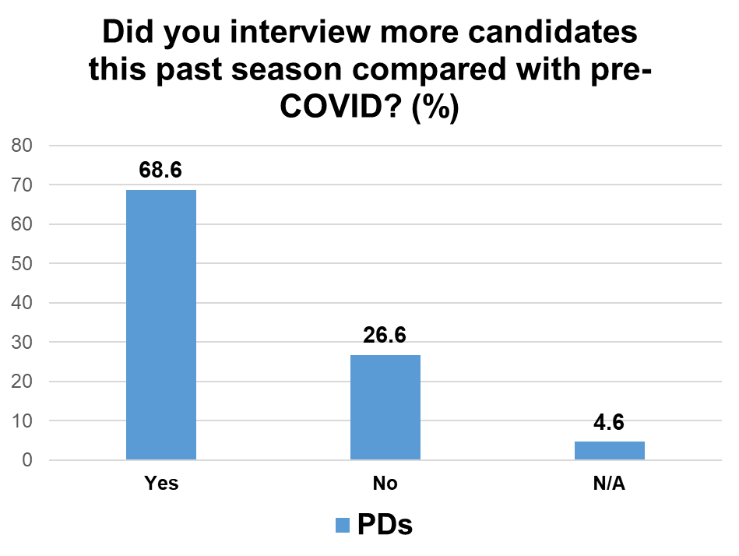
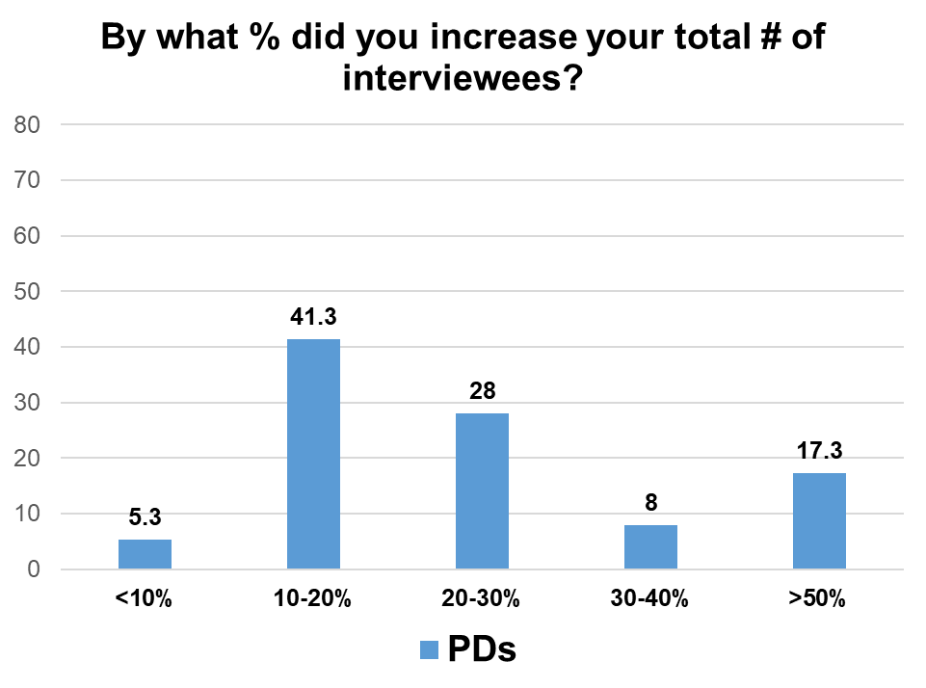
APDEM All In Match OversiMemorandum of Uhttps://www.surveymonkey.com/r/PT6F92Tnderstanding APDEM’s “All In” Policy for the Endocrinology Match (2022 Recruitment Season for appointment in the 2023-2024 academic year)ght Task Force
Notes:
Greg and Saira

Slide 42
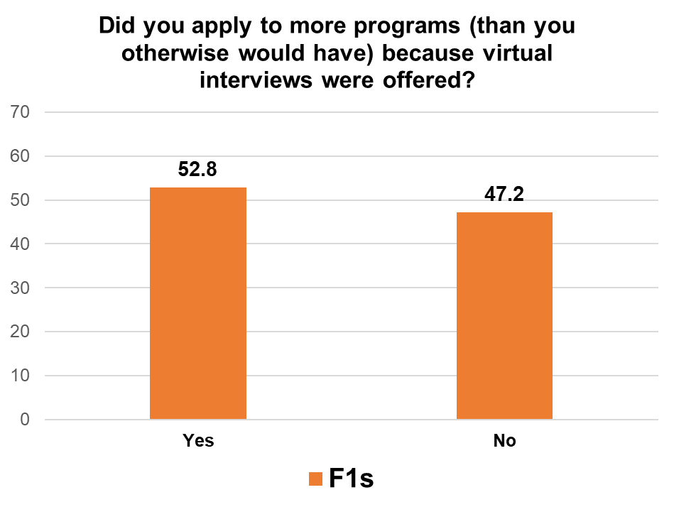
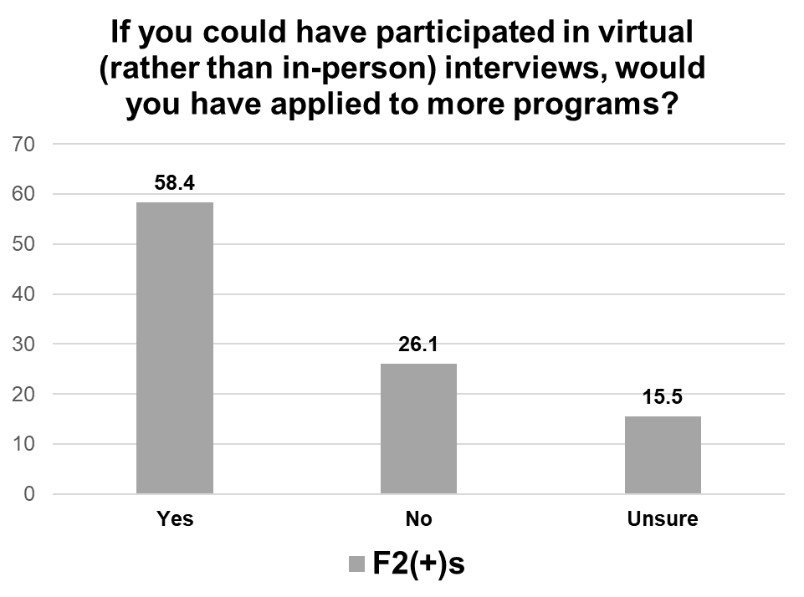
APDEM All In Match OversiMemorandum of Uhttps://www.surveymonkey.com/r/PT6F92Tnderstanding APDEM’s “All In” Policy for the Endocrinology Match (2022 Recruitment Season for appointment in the 2023-2024 academic year)ght Task Force
Notes:
Greg and Saira

Slide 43
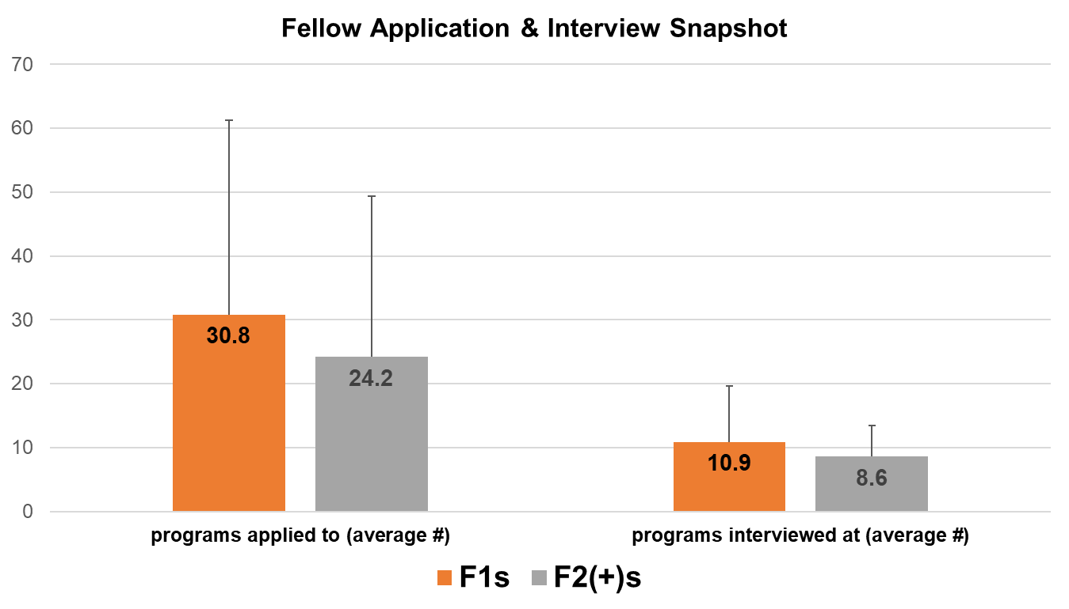
APDEM All In Match OversiMemorandum of Uhttps://www.surveymonkey.com/r/PT6F92Tnderstanding APDEM’s “All In” Policy for the Endocrinology Match (2022 Recruitment Season for appointment in the 2023-2024 academic year)ght Task Force
Notes:
Greg and Saira

Slide 44
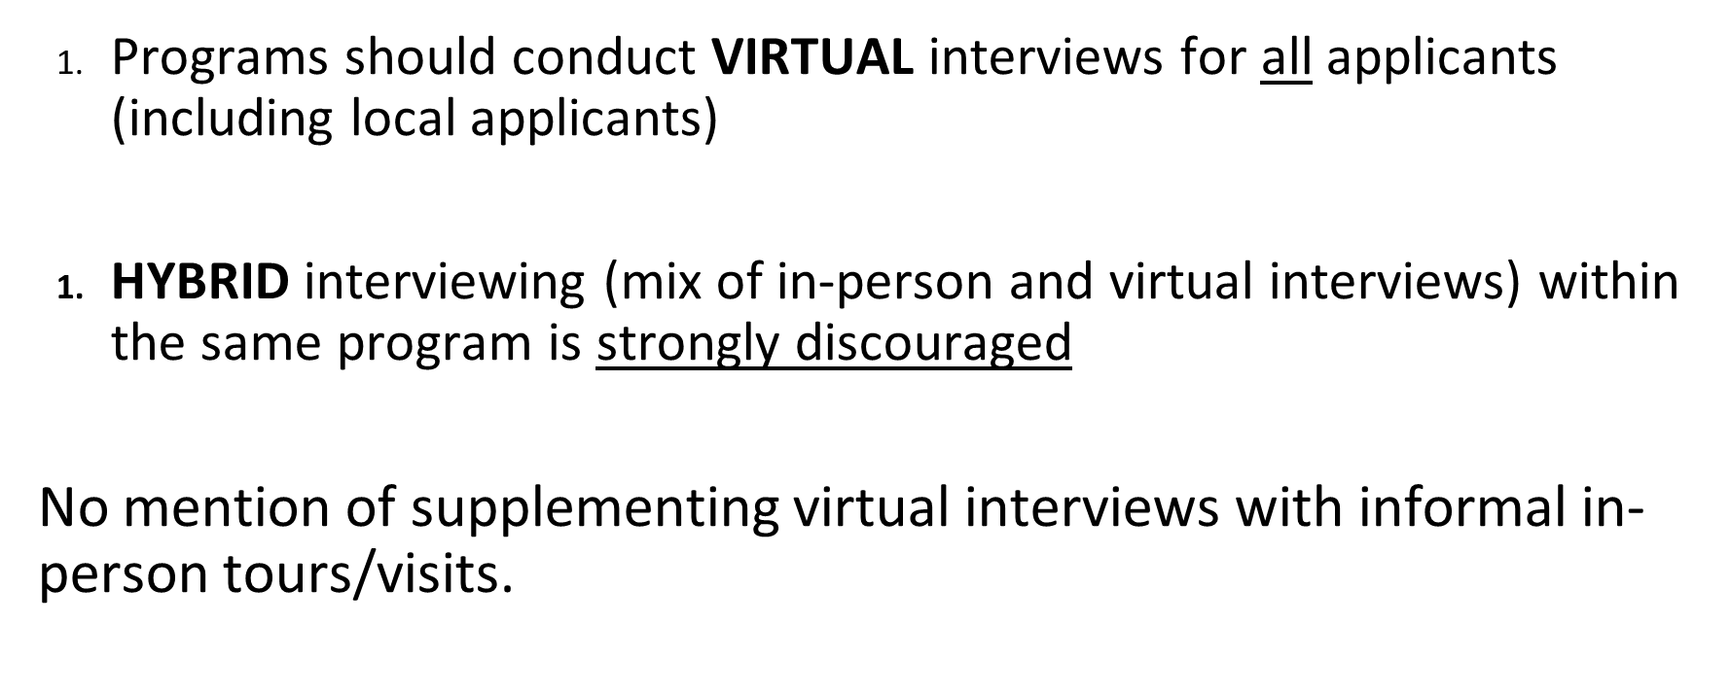
APDEM All In Match OversiMemorandum of Uhttps://www.surveymonkey.com/r/PT6F92Tnderstanding APDEM’s “All In” Policy for the Endocrinology Match (2022 Recruitment Season for appointment in the 2023-2024 academic year)ght Task Force
Notes:
Greg and Saira

Slide 45
APDEM All In Match OversiMemorandum of Uhttps://www.surveymonkey.com/r/PT6F92Tnderstanding APDEM’s “All In” Policy for the Endocrinology Match (2022 Recruitment Season for appointment in the 2023-2024 academic year)ght Task Force
Notes:
Greg and Saira

Slide 46
APDEM Diversity, Equity, and inclusion committee
Dr. Ricardo correa
6:52-6:56 p.m.
Notes:
Odelia

Slide 47
APDEM Diversity, Equity and Inclusion Committee (DEI)
Co-chairs: Rana Malek and Ricardo Correa
Rationale
ACGME Common Program Requirement to address health disparities
ACGME Milestone IM 2.0 (Professionalism) that evaluate concept of diversity and inclusion
AAMC Diversity, Inclusion and health equity mission area
Equity Matter project from ACGME given a structure on how to develop DEI project and programs
Notes:
Ricardo

Slide 48
APDEM Diversity, Equity and Inclusion Committee (DEI)
Updates
2 subcommittees Diversity/Inclusion and Health Equity
Part of Equity Matter of ACGME
Meeting with ABIM to report our DEI efforts and understand their DEI efforts
Survey that evaluates DEI was completed last year
Participation of 55% of PDs and 25% of fellows was achieved
Some data was presented last year
Next step will be a publication with all the data
Notes:
Ricardo

Slide 49
APDEM Diversity, Equity and Inclusion Committee (DEI)
Health Equity
Survey show a that PDs and fellows wanted to have a formal curriculum
Subcommittee developed a structured curriculum
Thanks to all the members that contributed and to Dr. Malek and Dr. Mason for their leadership
NEXT STEPS
Develop an assessment tool for the health equity curriculum
Focus on training the trainees
Notes:
Ricardo

Slide 50
APDEM Diversity, Equity and Inclusion committee (DEI)
Diversity and Inclusion
Survey showed low percentage of URMs in endocrinology, high women and IMGs as fellows but not as program leaders
Started conversation with special interest group to start building pipeline program (LMSA, SNMA, APAMSA)
Thanks to all the members that contribute to it especially Dr. Rahhal and Dr. Lieb
NEXT STEPS
Have more presence in URM healthcare organizations including webinars, annual meetings, etc.
Evaluate different options to attract more URMs to endocrinology
Partner with sister societies
Plan an unconscious bias training webinar focusing on interviews for all PDs
Notes:
Ricardo

Slide 51
ACGME Program Requirements for
Graduate Medical Education
in Endocrinology, Diabetes, and Metabolism
ACGME-approved Focused Revision: February 7, 2022; effective July 1, 2022
Dr. Andrew G. Gianoukakis
6:56 – 7:00 P.M.

Slide 52
2021 Endocrinology subspecialty exam ABIM pass rates 7:00 – 7:10 p.m.
Dr. Andrew G. Gianoukakis
Notes:
Andrew

Slide 53
2021 Endocrinology Subspecialty Exam ABIM Pass Rates
ABIM has not made significant changes to the board exam content and format (since 2018) that could impact the board passage rates
Most subspecialty disciplines experienced a decrease in passage rates from 2020-2021, up to 5%, while endocrine passage rates decreased by 15%
A greater percentage than usual of 2020 graduates, deferred testing to 2021 and were thus included together with the 2021 graduates in 2021 reported passage rates. There was a higher percentage of the traditionally lower-scoring candidates (i.e. lower ability test takers) in the 2021 pool.
As a result, 2021 1st time test takers were comprised of proportionally fewer 2021 graduates (similar across subspecialties) [lower ability test-taker effect]
5. However, in contrast to other specialties, the 2020 Endocrinology graduate 1st time test takers in 2021 (performed better than 2021 graduates (specific to Endo and not seen in other specialties) [2021 training effect vs candidate effect]
6. Additional points for consideration:
2021 candidates performed lower in Adrenal and pituitary and Female/male reproduction (compared to 2019 and 2020)
Candidates’ perception of fairness of the test has steadily declined from 2019 to 2021
In-person review course attendance dropped significantly while at home review increased significantly from 2019 to 2021.
Summary: A) Lower ability test taker effect (across specialties) combined with B) 2021 Endo specific, training effect vs candidate effect
“The Board will monitor the trends over the coming year in board passage rates and consider a deeper analysis should they continue to decline.”
Notes:
Greg/Saira

Slide 54
Milestones SURVEY DATA 7:10-7:15 p.m.
Dr. Geetha Gopalakrishnan
Notes:
Andrew introduce

Slide 55
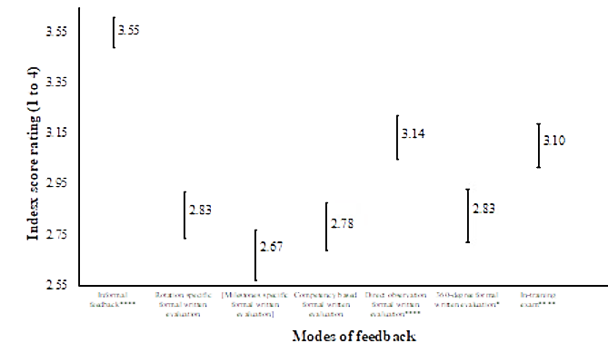
Index score rating (1 to 4)
Informal feedback****
Rotation specific evaluations
Milestone specific evaluations
Competency based evaluations
Direct observation evaluations
360-degree evaluation
In-training exam
Modes of feedback
Notes:
Fellow: 305; PD: 61; Faculty: 56
PD 3% and 6% CCC/APD
9% fellows report milestones discussed annually and 5% not discussed at all

Slide 56
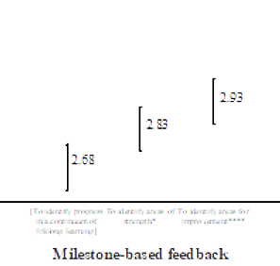
To identify program in a continuum of lifelong learning
To identify areas of strength*
To identify areas for improvement****
Milestone-based feedback

Slide 57
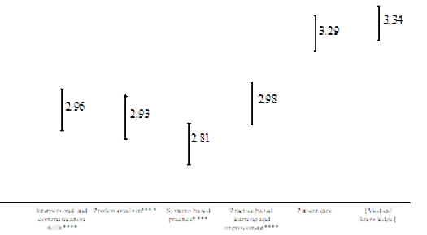
Interpersonal and communication skills****
Professionalism****
Systems based practice****
Practice based learning and improvement****
Patient care
Medical knowledge

Slide 58
Program Director
All other faculty
Fellow
Index score rating (1 to 4)
Interpersonal and communication skills
Professionalism
Systems based practice
Practice based learning and improvement
Patient care
Medical knowledge

Slide 59
Comments
“Clicking a button to indicate where someone falls on essentially a Likert scale becomes both very subjective and very unhelpful to the growth of the trainee. [The milestones] need to be pared down drastically…to make them useful and reliable going forward.”
“The challenge [with providing feedback] is to make attendings feel comfortable giving feedback directly to the fellow at the time of patient encounters instead of using program director as the giver of all the feedback, which usually ends up being more vague.”
“I always find this difficult to evaluate. By the time you reach fellowship you should already have professionalism. “
“Fellows and faculty probably don’t actually understand what this is (System-based practice). It seems a bit like an abstract concept, an impression we can give – but what are the concrete elements?”
“How do we evaluate this (Practice based learning)? How do we teach this?”

Slide 60
Next Steps
Educational Opportunities
Professionalism
Interpersonal skills and communication
System-based practice
Practice-based learning
Evaluations
Are there ways to improve rotation-based and 360 evaluations?
Does Milestones 2.0 address some of the limits identified in milestones 1.0?
Is it getting better at addressing areas of strength and lifelong learning in addition to areas of improvement?
Is it getting better at evaluating and providing feedback on professionalism, interpersonal skills/communications, system-based practice and practice-based learning?

Slide 61
Questions and Clarifications (in Q&A box) 7:15 – 7:25 p.m.
Notes:
Andrew

Slide 62
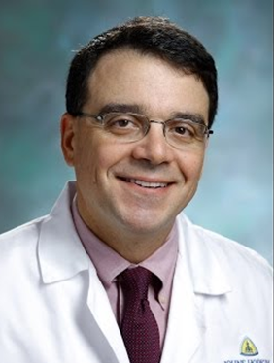
Thank You Outgoing Officers
Council Member
Roberto Salvatori, MD Johns Hopkins University
Notes:
Odelia

Slide 63
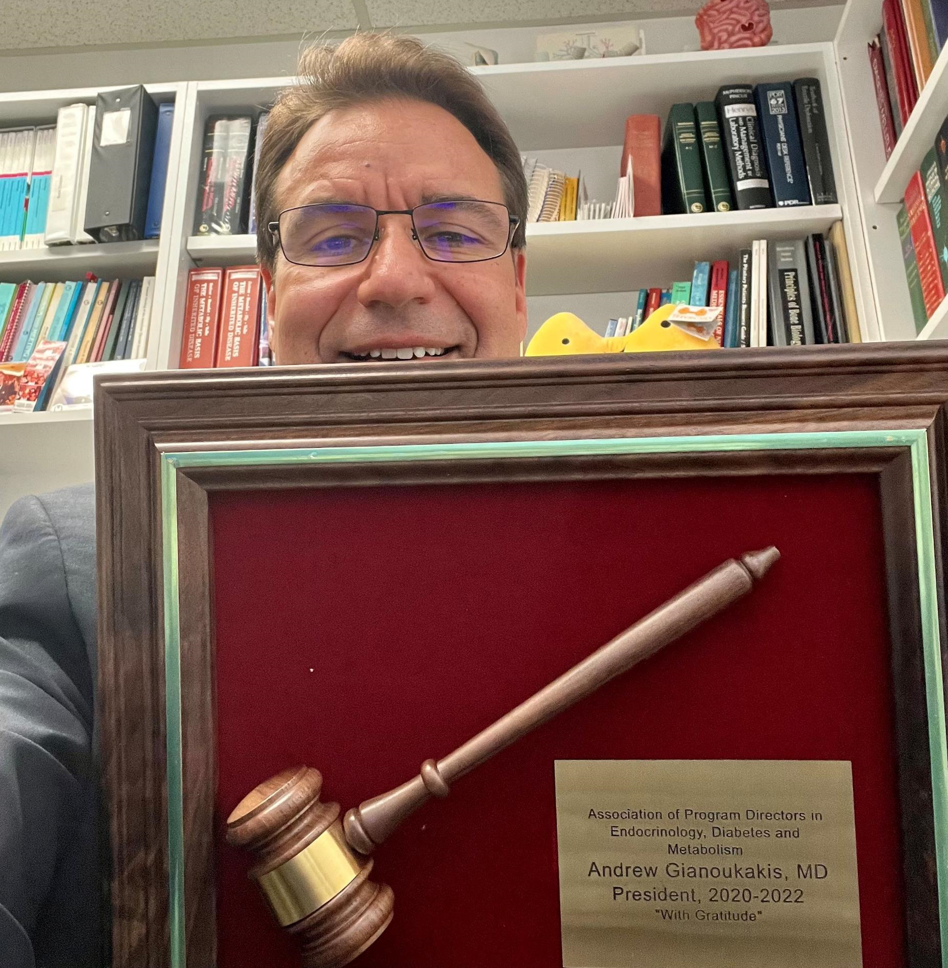
Notes:
Odelia

Slide 64
Passing the Baton
Notes:
Andrew

Slide 65
Thank you

